Slide 1
Economic Goals & Indicators
Price Stability
Economic Growth
Full Employment

Slide 2
how we know if we are meeting these goals??
Economic Indicators

Slide 3
Economic Indicators
Unemployment rate
Inflation rate
Consumer price index
Growth rate
Gross National / Domestic Product

Slide 4
GNP or GDP
What is the difference between real GNP and nominal GNP?
Why does this measure often appear as a GNP %? Explain.
Why might per capita GNP be an important factor to consider?

Slide 5
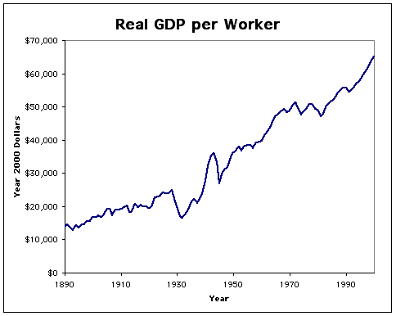
Gross Domestic Product
A measure of a country's overall economic output.
It is the market value of all final goods and services made within the borders of a country in a year.
Measured by Quarters and compared -to calculate growth rate
Real vs Nominal: Does the stat account for inflation?

Slide 7
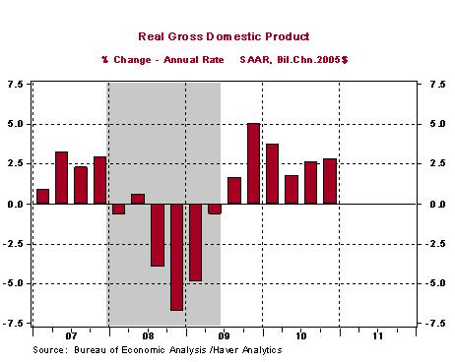
RECESSION

Slide 8
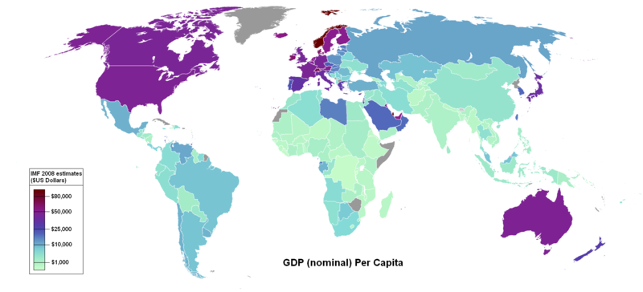

Slide 9
Unemployment Rates
Why doesn’t the employment rate and unemployment rate always add up to 100%?
Why, and how is it possible that both the employment and unemployment rates have risen at certain period in the latter part of the 20th century?
In general terms, how is unemployment calculated? Why is 0% unemployment unrealistic?

Slide 10
Unemployment Rates
People who are looking for work who can not find it!
NOT stay at home parents
NOT institutionalized individuals
NOT people under 16 years of age
Less than 5% is generally considered a healthy economy

Slide 11
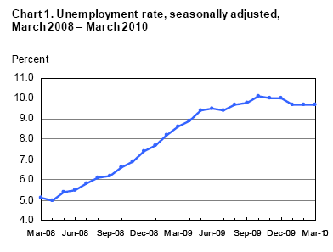

Slide 12
Types of Unemployment
Frictional
Always exists – changing jobs
Seasonal
Jobs that exist at only certain times of year
Structural
The economy changes and so do the jobs that people do!
Cyclical
Demand for workers increases and decreases with periods of recession and expansion

Slide 13
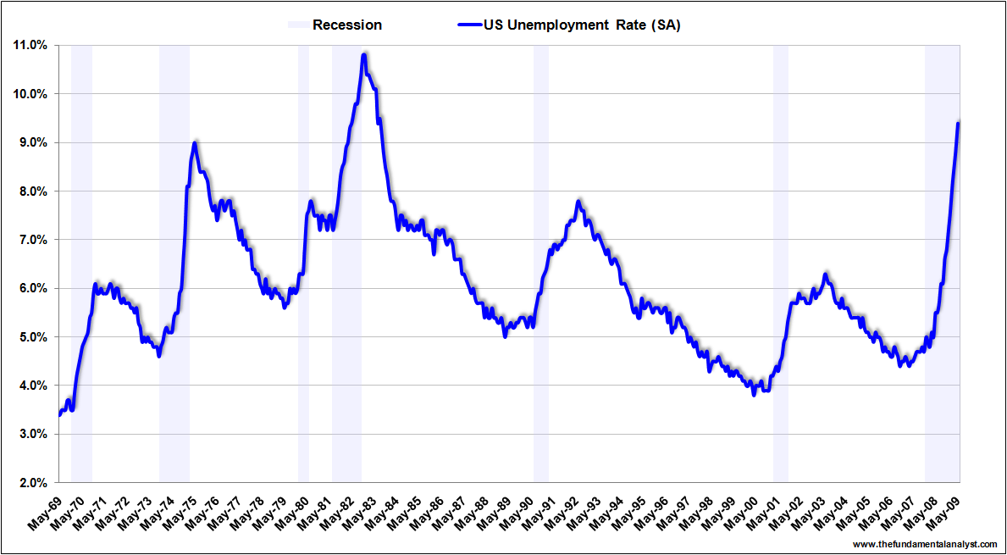

Slide 14
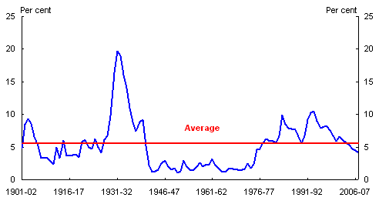

Slide 15
Consumer Price Index - Inflation
What is a price index, and specifically the Consumer Price Index?
How does the market basket help create this index?
Why, like the GDP, does price stability appear as a percent?

Slide 16
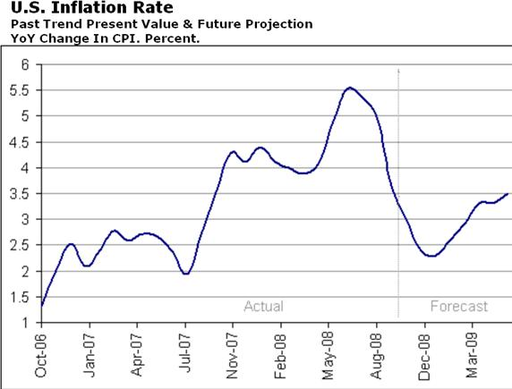
Consumer Price Index (CPI)
Market Basket of approximately 400 goods
Base price is compared to new price of index products
The change is then presented in % form

Slide 17
Types & Causes of Inflation
Types
1 – 3 % average healthy economy
Over 5% problematic
Core Inflation rate (excluding food and energy)
Hyperinflation (out of control)
Stagflation (inflation and unemployment)
Causes
Quantity Theory ( Too much money in supply)
Demand – Pull Theory (demand exceeds supply of goods and services)
Cost - Push Theory (Increasing production costs passed on to consumers)

