Slide 1
Ancient Greece
Origins –to Alexander’s Hellenistic Age

Slide 2
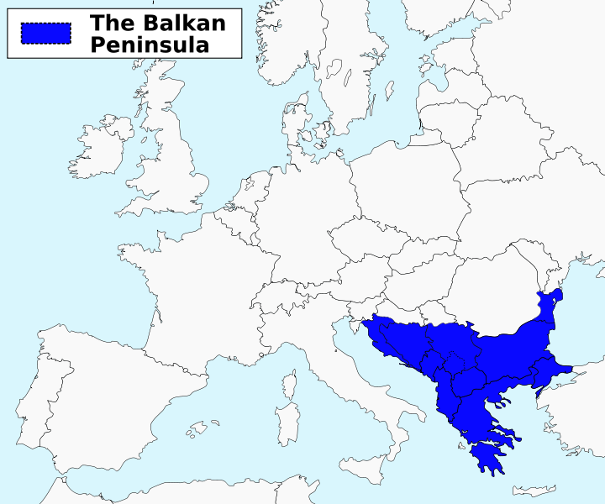

Slide 3
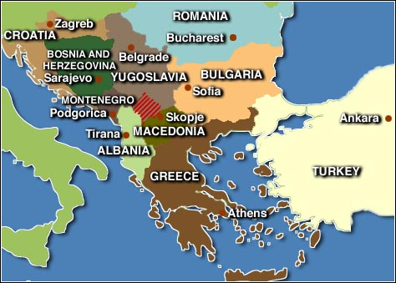

Slide 4
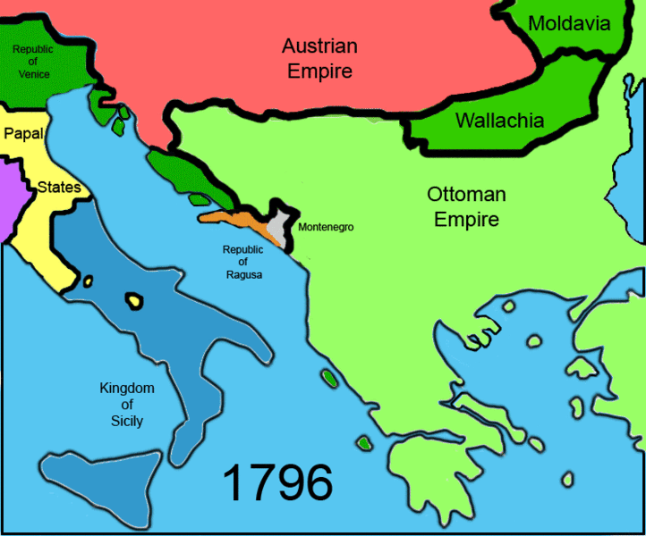

Slide 5
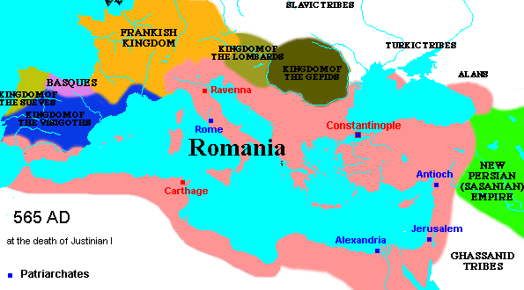

Slide 6
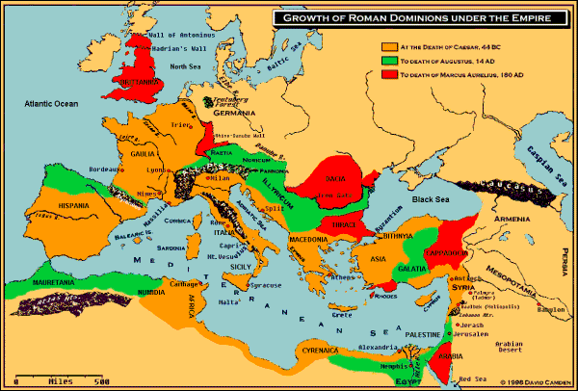

Slide 7
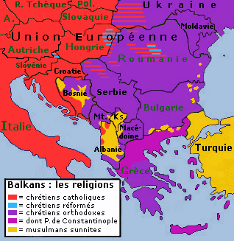
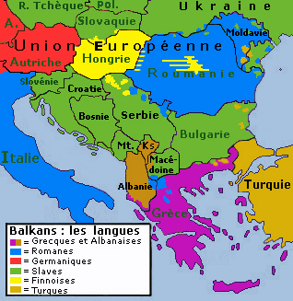
languages
religions

Slide 8
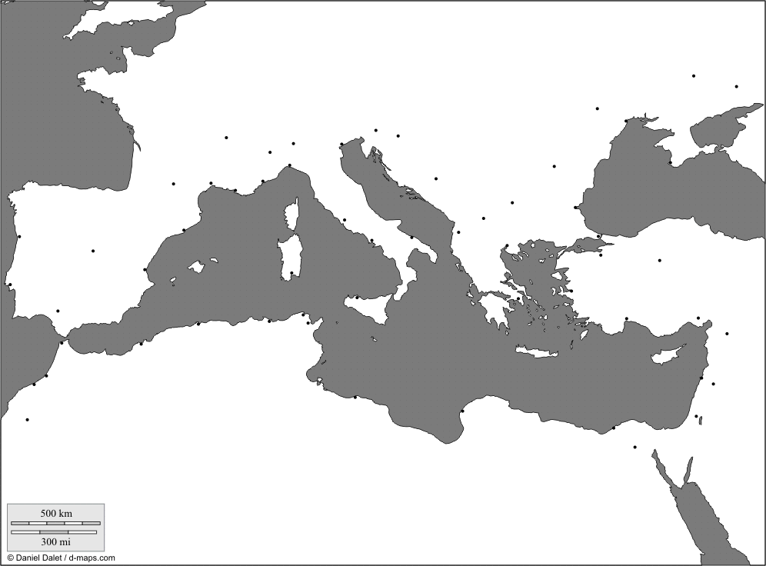

Slide 9
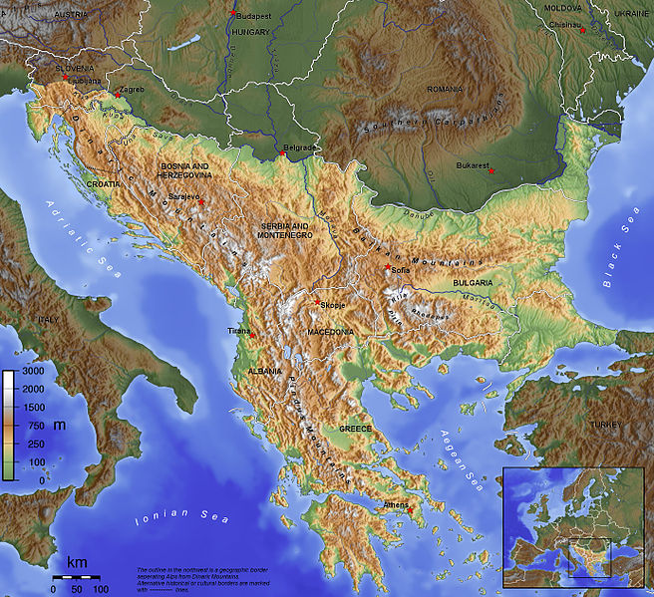

Slide 10
Geography
Early Development Difficult
Advantage: Bodies of Water, not a singular river system with fertile plains, and Natural Harbors
Mediterranean Sea
Aegean Sea
Political Impact: Balkan Mountains, not large enough to prevent development, but too imposing to allow for political unity
City States: Polis

Slide 11
Greek Identity: People of Hellas
…the concept of a nation (or national identity), ..is often defined in terms of common origin, ethnicity, or cultural ties
Early History of the Aegean Sea (before 800 BCE)
Piracy and lawlessness
Centralization of political power for, and as a result of, prosperous trade (Crete, Urban development on Balkan Coast and Islands)
Competing and cooperating trade-based civilizations
Mycenaean and Minoan
Mycenaean Dominance and Conflict
Dark Age: Invasions from the north, so-called “Dorian Invasions”

Slide 12
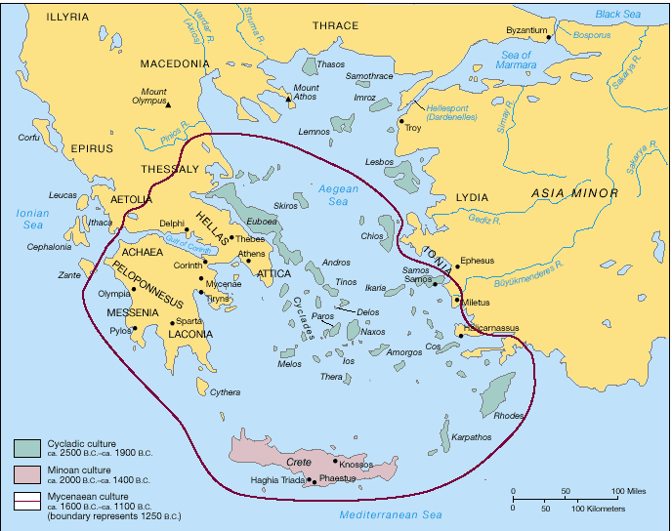

Slide 13
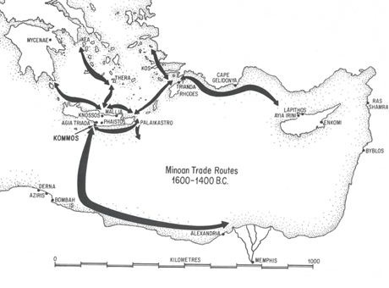

Slide 14
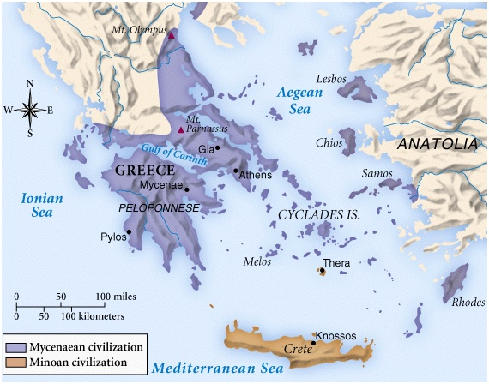
MYCENAEAN
MINOAN

Slide 15
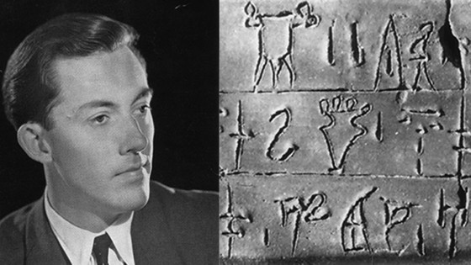
Linear B: deciphered 1953
Michael Ventris

Slide 16
MYCENAEAN
MINOAN

Slide 17
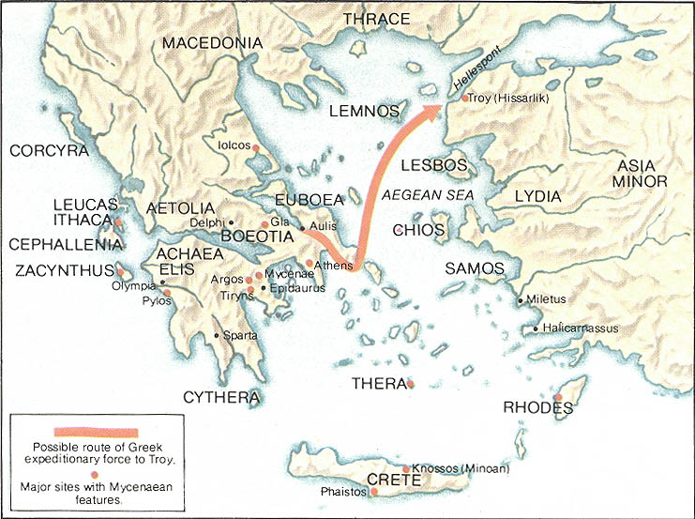
Trojan War, myth or history
Approx. 1194–1184 BC

Slide 18
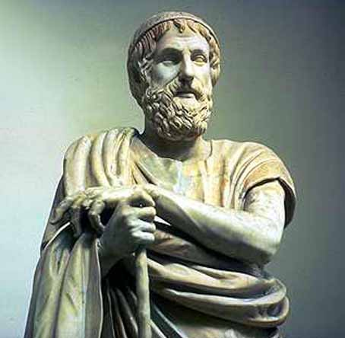

Slide 19
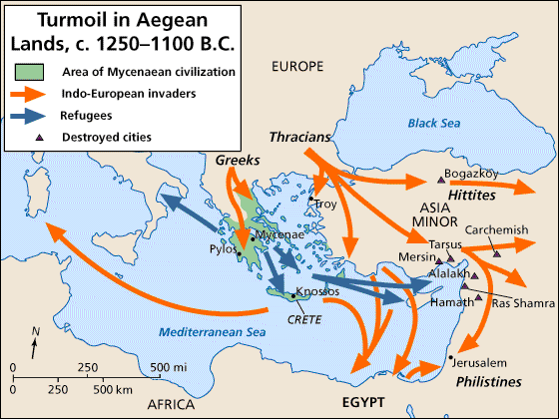
Dark Age: a period of transition

Slide 20
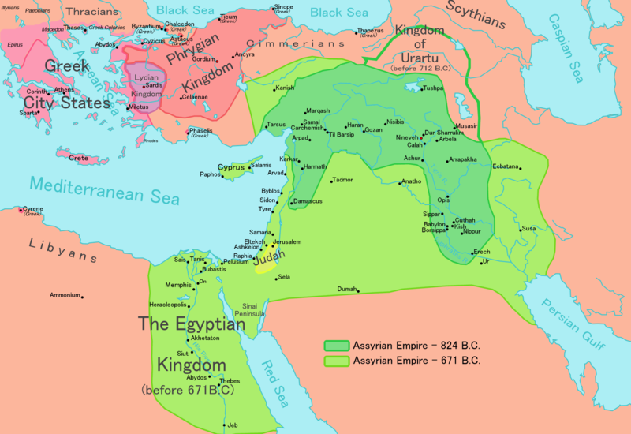

Slide 21
Political & Cultural Evolution
Regular chaos inland and on the seas overtime gave rise to a more orderly expansion of trade, urbanization and orderly, hierarchal society.
In the end, the people of the Balkans identified with one another through a shared space and common history.

Slide 22
Archaic Greece
800 BCE – 480 BCE

Slide 23
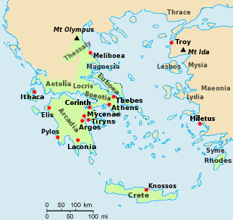
Homer’s Greece, 8th C BCE

Slide 24
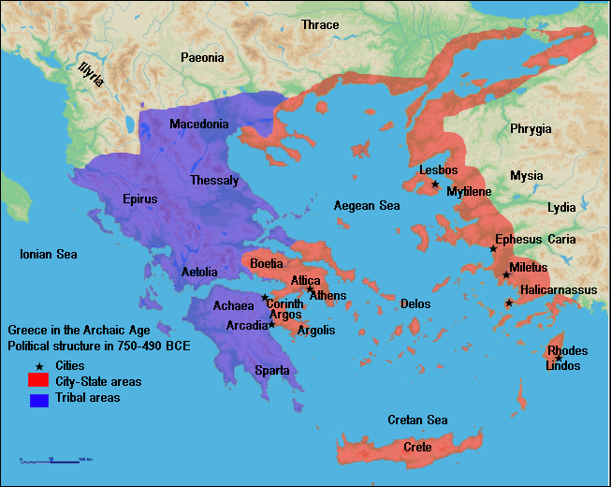

Slide 25
The Poleis: City States
Emerged from the ruin of the Mycenaean sites after the Dark Age
Common Language – spoken and written
Phoenician Alphabet
Common Polytheistic Religion
Myths
Delphi - oracles
No organized, recognized priestly class

Slide 26
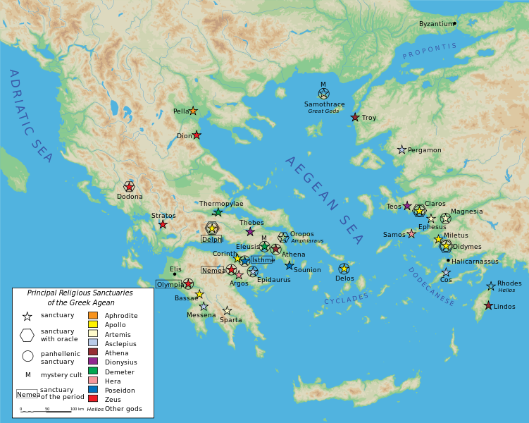

Slide 27
Athens
Athenian Statesmen…
Draco
first penal and civil law code
Solon
Established Council and Assembly
Cleisthenes
Pericles
Evolution of Democracy

Slide 28
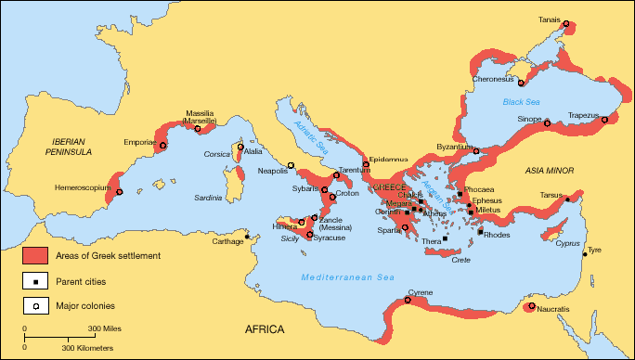
Greek Colonization Archaic period

Slide 29
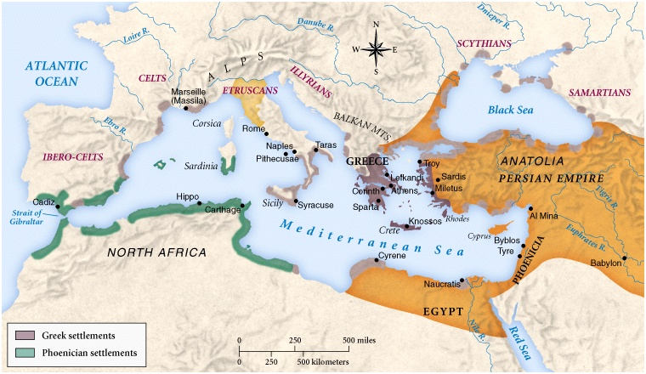
Early Classical Age

Slide 30
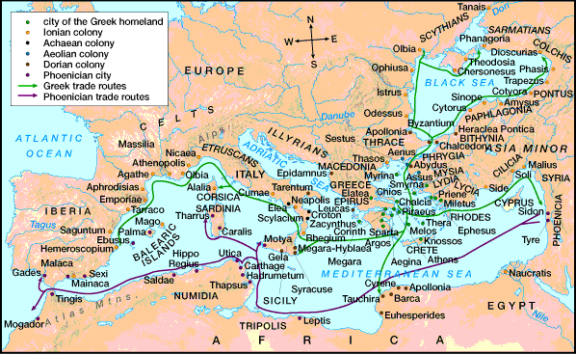
Iron Age

Slide 31
Athenian Relations
Domestic & Foreign

Slide 32
Greek Golden Age
480BCE to 323BCE

Slide 33
Athenian Life
How would you characterize the Classical Age of Ancient Greece, and specifically Athens?

Slide 34
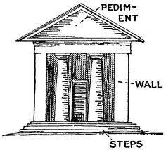
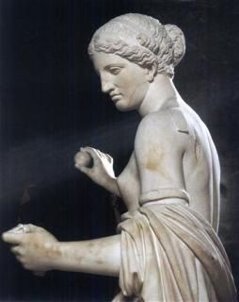
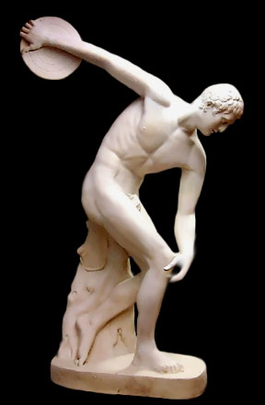
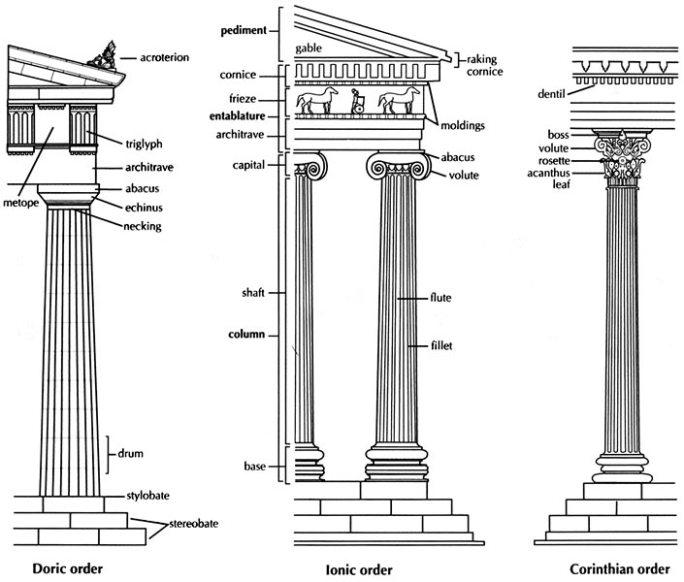
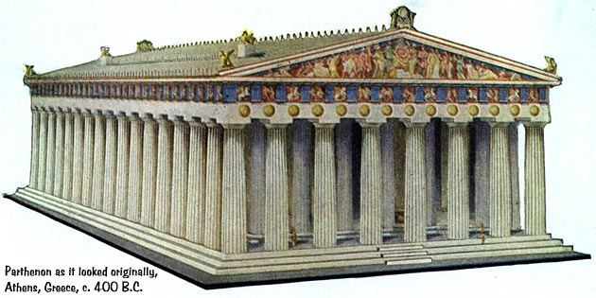
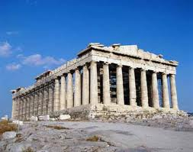
Classical period

Slide 35
Significance…
The art of Classical Greece began the trend towards a more naturalistic (even in its early idealistic state) depiction of the world, thus reflecting a shift in philosophy from the abstract and supernatural to more immediate earthly concerns. Artists stopped merely “suggesting” the human form and began “describing” it with accuracy.
Evidence…
“Logic over Emotion” approach is frozen on the faces of the statues of the temple of Zeus west pediment at Olympia. In the complex array of sculptures, it is easy to know who is a “Barbarian” and who is a “civilized Hellene” through the expression of their faces. Barbarian Centaurs exhibit an excess of emotion, while Lapithae women and Apollo remain collected and emotionless even in the direst of situations.

Slide 36
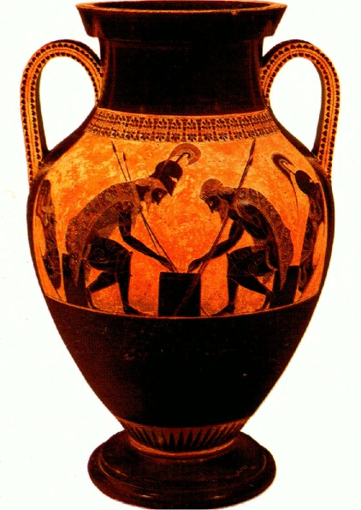
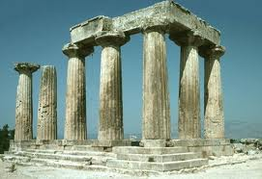
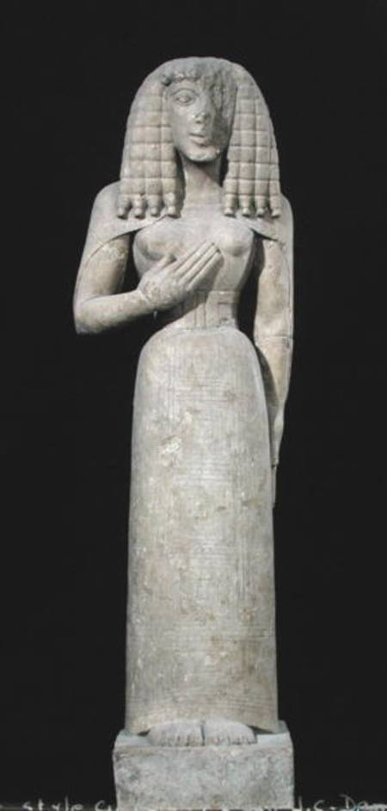
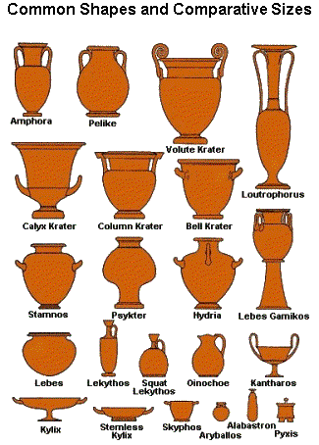
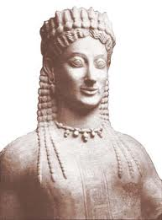
Archaic Period

Slide 37
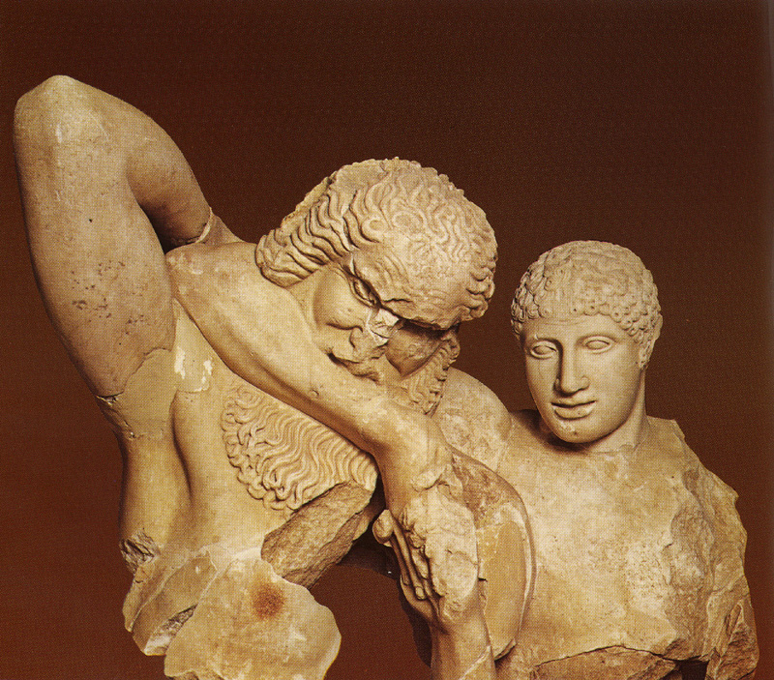
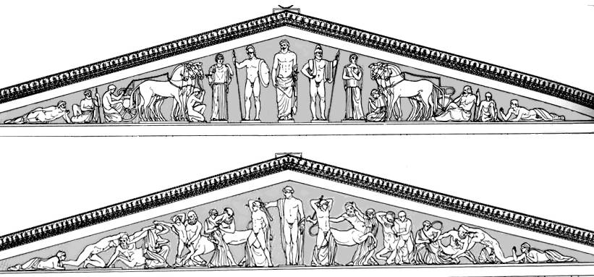
Temple of Zeus west pediment at Olympia

Slide 38
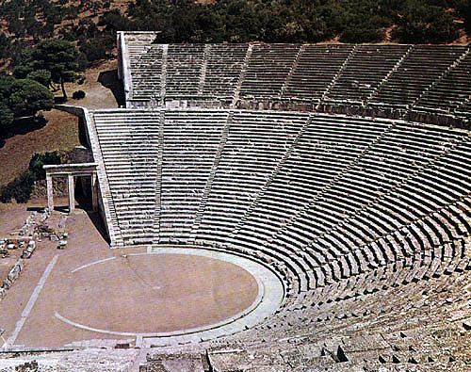
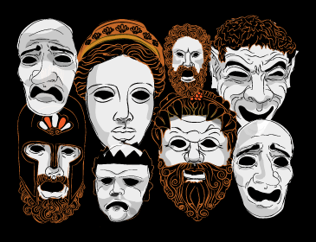
Dramatic Genres:
Tragedy, Comedy and Satire Major Playwrights:
Sophocles, Aeschylus and Euripides, Aristophanes Major Theatres:
Epidaurus and Dionysus

Slide 39
Greek Classical Age Scientific Understanding
Discoveries in astronomy and development in calendar creation…
Pythagoras (569 to 475 BC)
Cult was devoted to the study of numbers
concrete, material objects, and the ultimate principle of all proportion, order, and harmony in the universe
Pythagorean theorem
Pythagoreans were the first to consider the earth as a globe revolving with the other planets around a central fire and mathematize the universe.
Democritus (460 BC - 370 BC)
among the first to observe that a cone or pyramid has one-third the volume of a cylinder or prism respectively with the same base and height.
proposed that the universe contains many worlds, some of them inhabited and conducted research on minerals and plants.
Significance: Scientific Understanding of the world, as opposed to….

Slide 40
Family & citizenship
The family together with its land was called an oikos- inheritence key!
All Citizen men could participate in the Athenian democracy
Thucydides makes Pericles speak in the Funeral Oration at the beginning of the Peloponnesian War:
“We cultivate refinement without extravagance and knowledge without effeminacy; wealth we employ more for use than for show, and place the real disgrace of poverty not in owning to the fact but in declining the struggle against it. Our public men have, besides politics, their private affairs to attend to, and our ordinary citizens, though occupied with the pursuits of industry, are still fair judges of public matters; for, unlike any other nation, regarding him who takes no part in these duties not as unambitious but as useless, we Athenians are able to judge at all events if we cannot originate, and instead of looking on discussion as a stumbling-block in the way of action, we think it an indispensable preliminary to any wise action at all. . . . In short, I say that as a city we are the School of Hellas.”

Slide 41
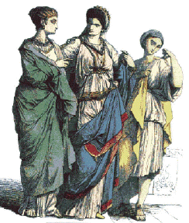
The Athenian Women’s Role
Seclusion within the home, veils in some cases outside
Dowry paid by father or guardian
Guardianship – Kyrios
No property ownership
Responsibilities included.. manage the household and produce an heir
Athenian reality versus the Athenian ideal?

Slide 42
Spartan Differences
…not so spartan!

Slide 43
City-State Sparta
Location:
Government
Gender & Family
Society, Economy & Specialization:

Slide 44
Alexander’s Conquest
The Hellenistic Age

