Slide 1
The Hellenistic Legacy
Alexander the Great

Slide 2
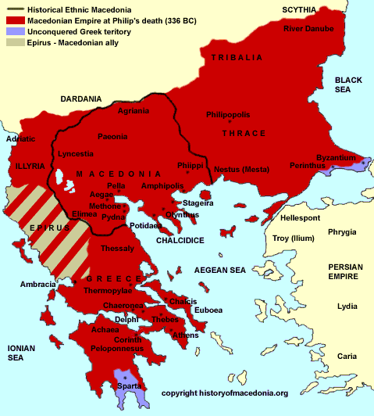

Slide 4
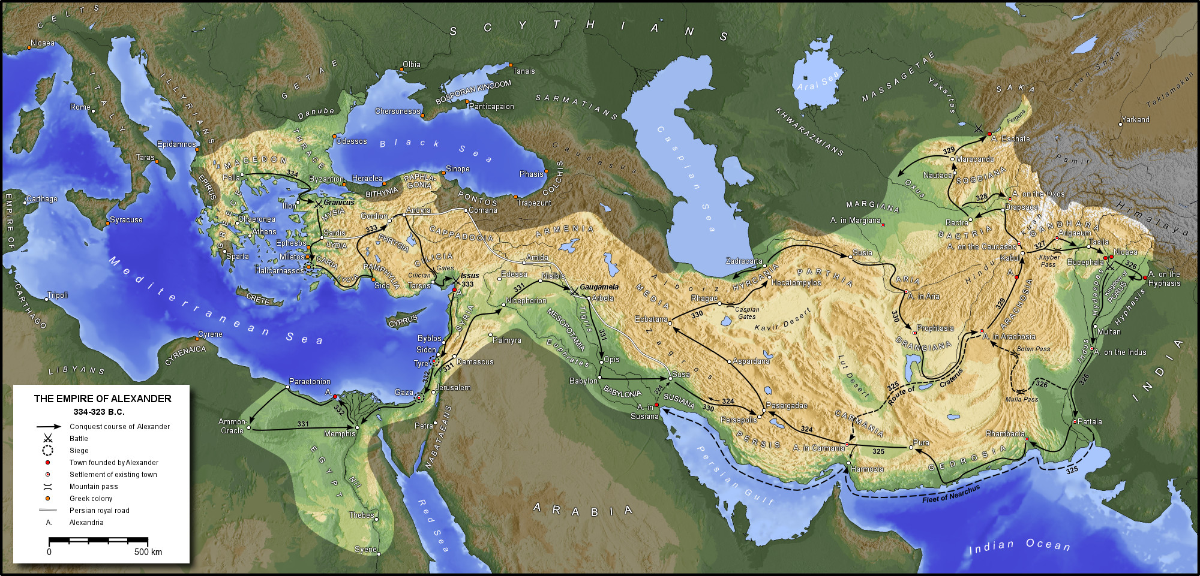

Slide 5
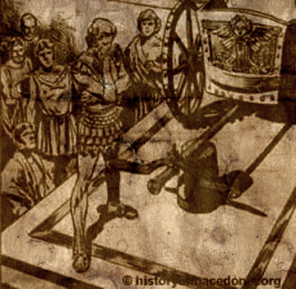
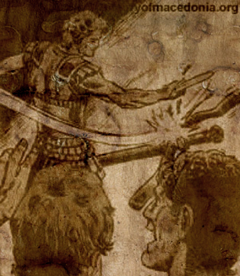
Alexander slashing the Gordian Knot

Slide 7
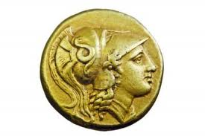
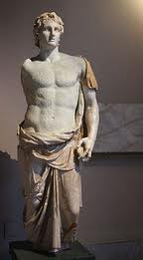
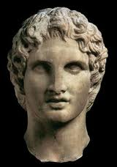

Slide 8
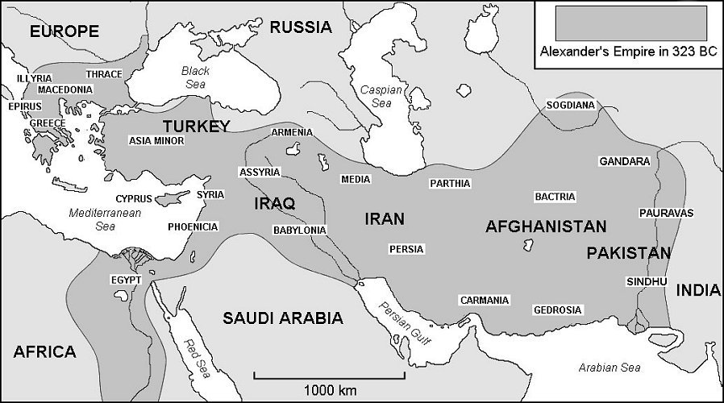

Slide 9
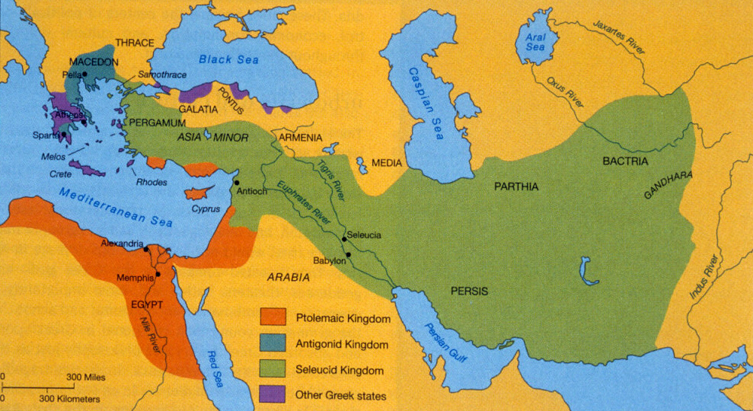
Alexander’s Empire after his death

Slide 10
Alexander’s Legacy
Ironically, not political, but cultural

Slide 11
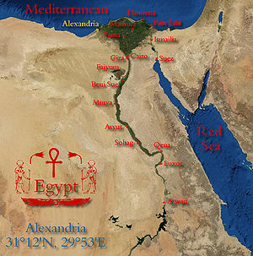
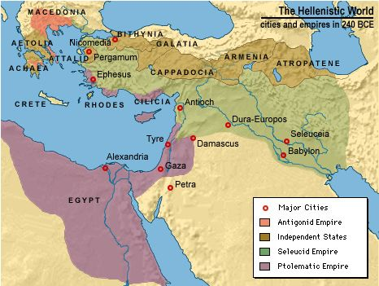
Hellenistic Contributions

Slide 12
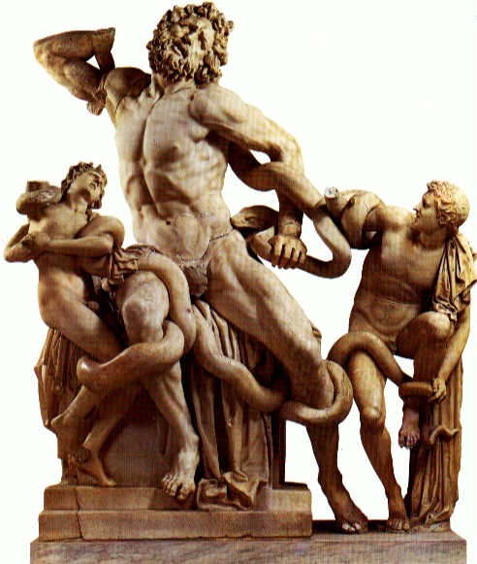
Artistic, Philosophical & Scientific Accomplishment
Philosophy…
Epicurians
Cynics
Stoics
Science…
Aristarchus of Samos -called the "Hellenistic Copernicus."
Euclid -geometry.-synthesis of the discoveries of others
Galen, the first to practice human dissection
Archimedes, Give me a place to stand on, and I will move the Earth

Slide 13
Why? …
Such Success in Cultural Achievements
Alexander as patron ($)
Intellectual inquiry - the fusion of Chaldean (Mesopotamia) and Egyptian science with the learning of the Greeks.
New interest in luxury and the demand for practical knowledge

Slide 14
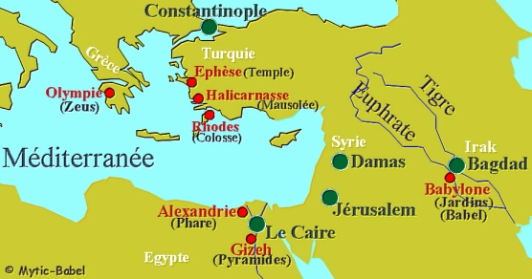
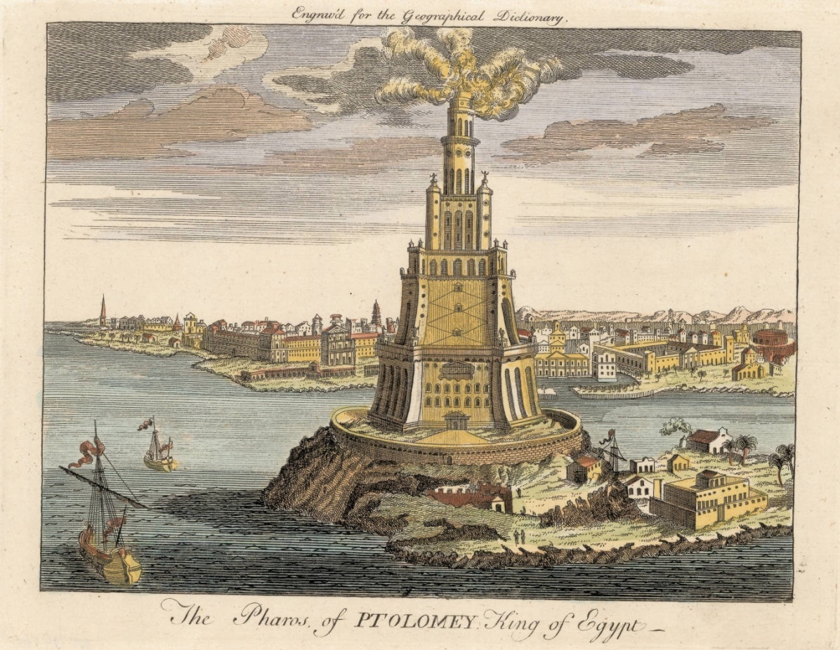
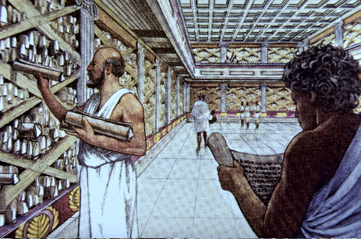

Slide 15
Alexander’s Legacy
Ironically, not political, but cultural
Hellenistic Synthesis: Golden Age

